Slide 1
تقييم الجامعات

Slide 2
إعداد
أحمد يحيي عبدالهادي
إشراف
محمد عبدالمقصود محمد
حسن أحمد قاحوف
د/ أميرة العطار
أ.م.د/ ريهام عيسى
أ.م.د/ عمرو الشورى
د/ منى موافي

Slide 3
TABLE OF CONTENTS
01
02
03
04
OVERVIEW
FEATURES OF THE TOPIC
ANALYSIS PHASES
USER INTERFACES

Slide 4
01
SECTION
OVER VIEW

Slide 5
INTRODUCTION
It is a project that evaluates Egyptian universities through the quality of education, entertainment institutions and facilities, and this makes it easier for students to choose the right university.

Slide 6
02
SECTION
FEATURES OF THE TOPIC

Slide 7


FEATURES OF THE TOPIC
INTERNET
DATABASE
EVALUATION
PROGRAMMING

Slide 8
INTERNET
The Internet is a global communication system for transmitting data over various types of media, describing a global network that connects various private, public, commercial, academic, or governmental networks by means of technologies, or optical fibers, the communication protocol in the Connection Control Protocol / Internet Protocol (English: TCP / IP), which supplies it to its host and can access the Internet, the Internet has raised public network standards to global norms.

Slide 9
DATABASE
A database is an organized collection of structured information, or data, typically stored electronically in a computer system. A database is usually controlled by a database management system (DBMS). Together, the data and the DBMS, along with the applications that are associated with them, are referred to as a database system, often shortened to just database

Slide 10
EVALUATION
Evaluation is a systematic determination of the merits, value and importance of a subject, using criteria governed by a set of criteria. It can assist an organization, programme, design, project or other initiative to evaluate any objective or concept in relation to the objective and the results of any work undertaken.
The primary purpose of evaluation, in addition to gaining insight into past or current initiatives, is to enable reflection and help identify future change.

Slide 11
PROGRAMMING
Programming is the process of creating a set of instructions that tell a computer how to perform a task. Programming can be done using a variety of computer programming languages, such as JavaScript, Python, and C++. Created by Pamela Fox.

Slide 12
OUR PROGRAMMIN LANGUAGES
HTML
CSS
JAVASCRIPT
JSON

Slide 13
03
SECTION
ANALYSIS PHASES

Slide 14
ANALYSIS PHASES

Slide 15
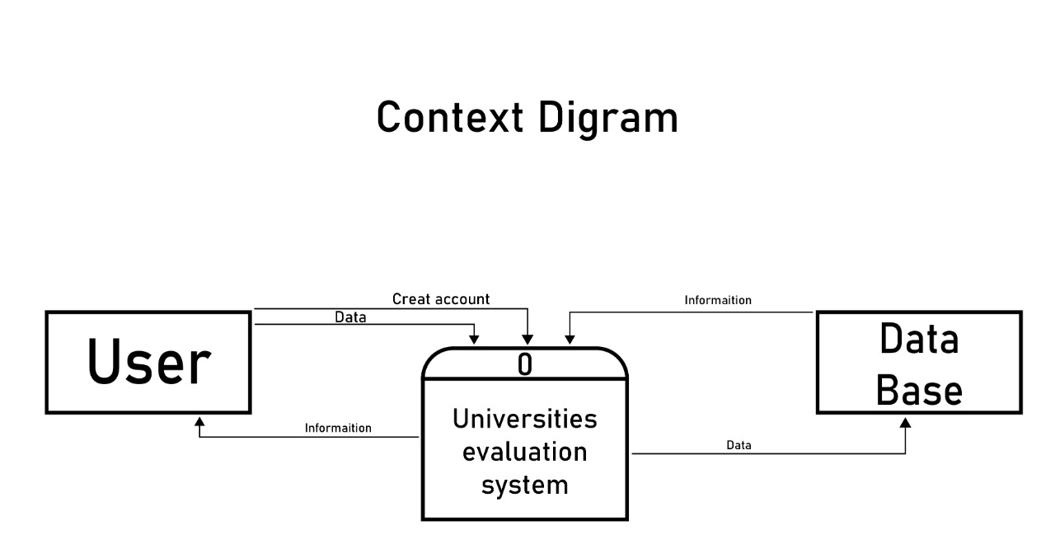
ANALYSIS PHASES

Slide 16
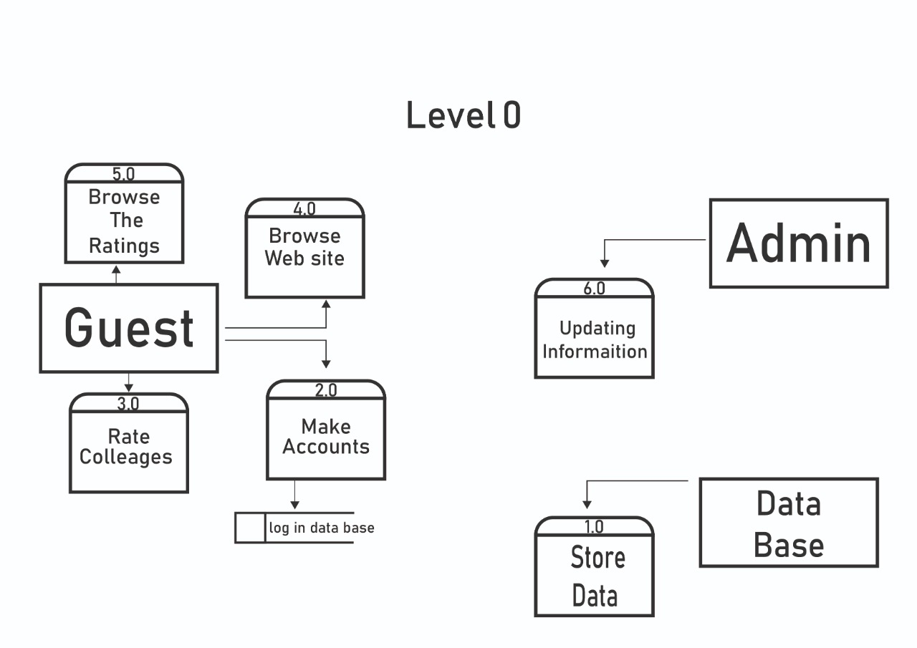
ANALYSIS PHASES

Slide 17
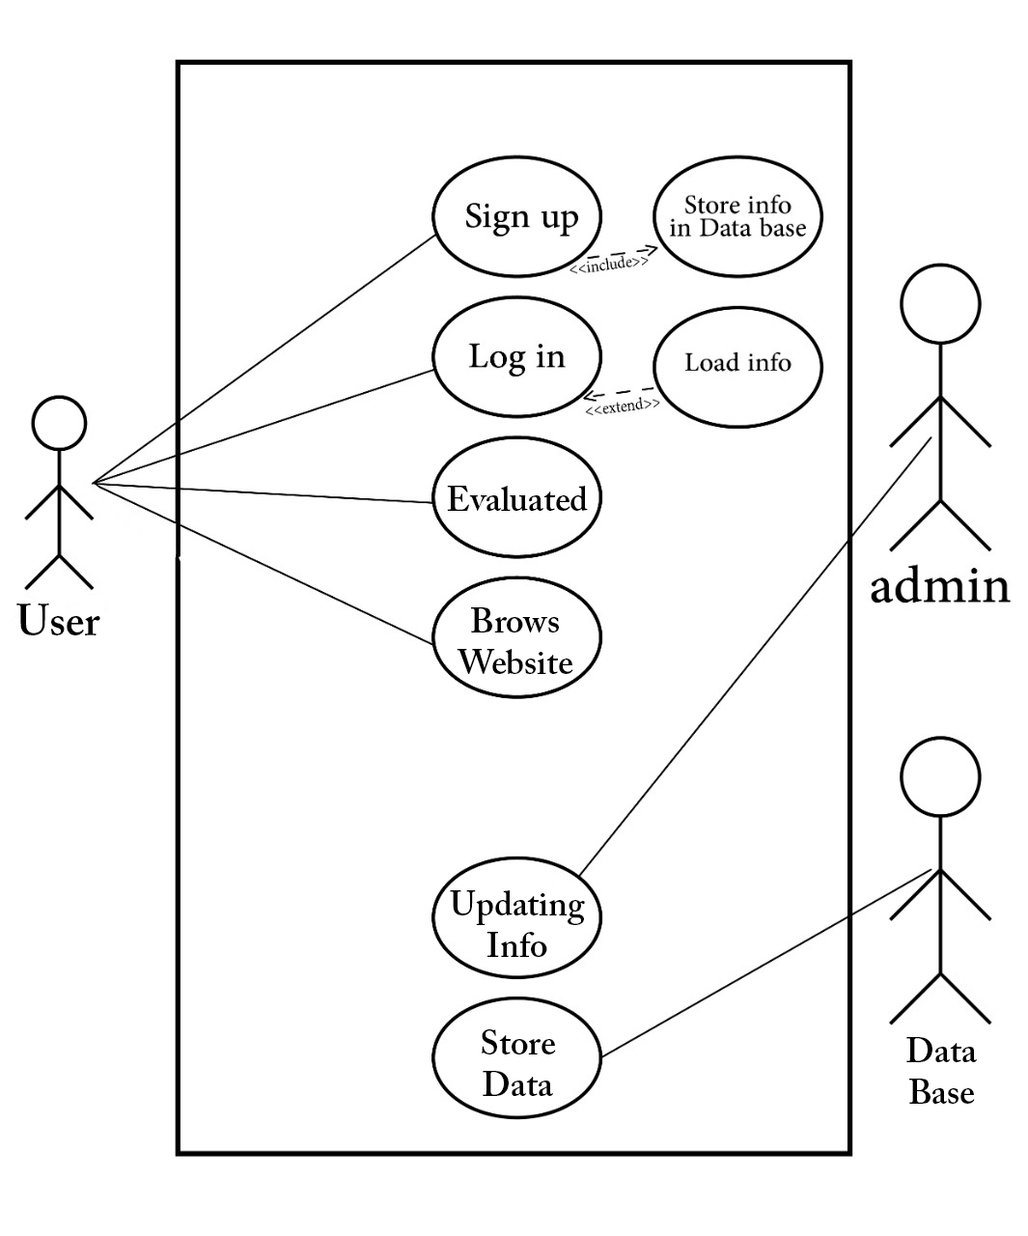
ANALYSIS PHASES

Slide 18
03
SECTION
USER INTERFACSE

Slide 19
USER INTERFACSE

Slide 20
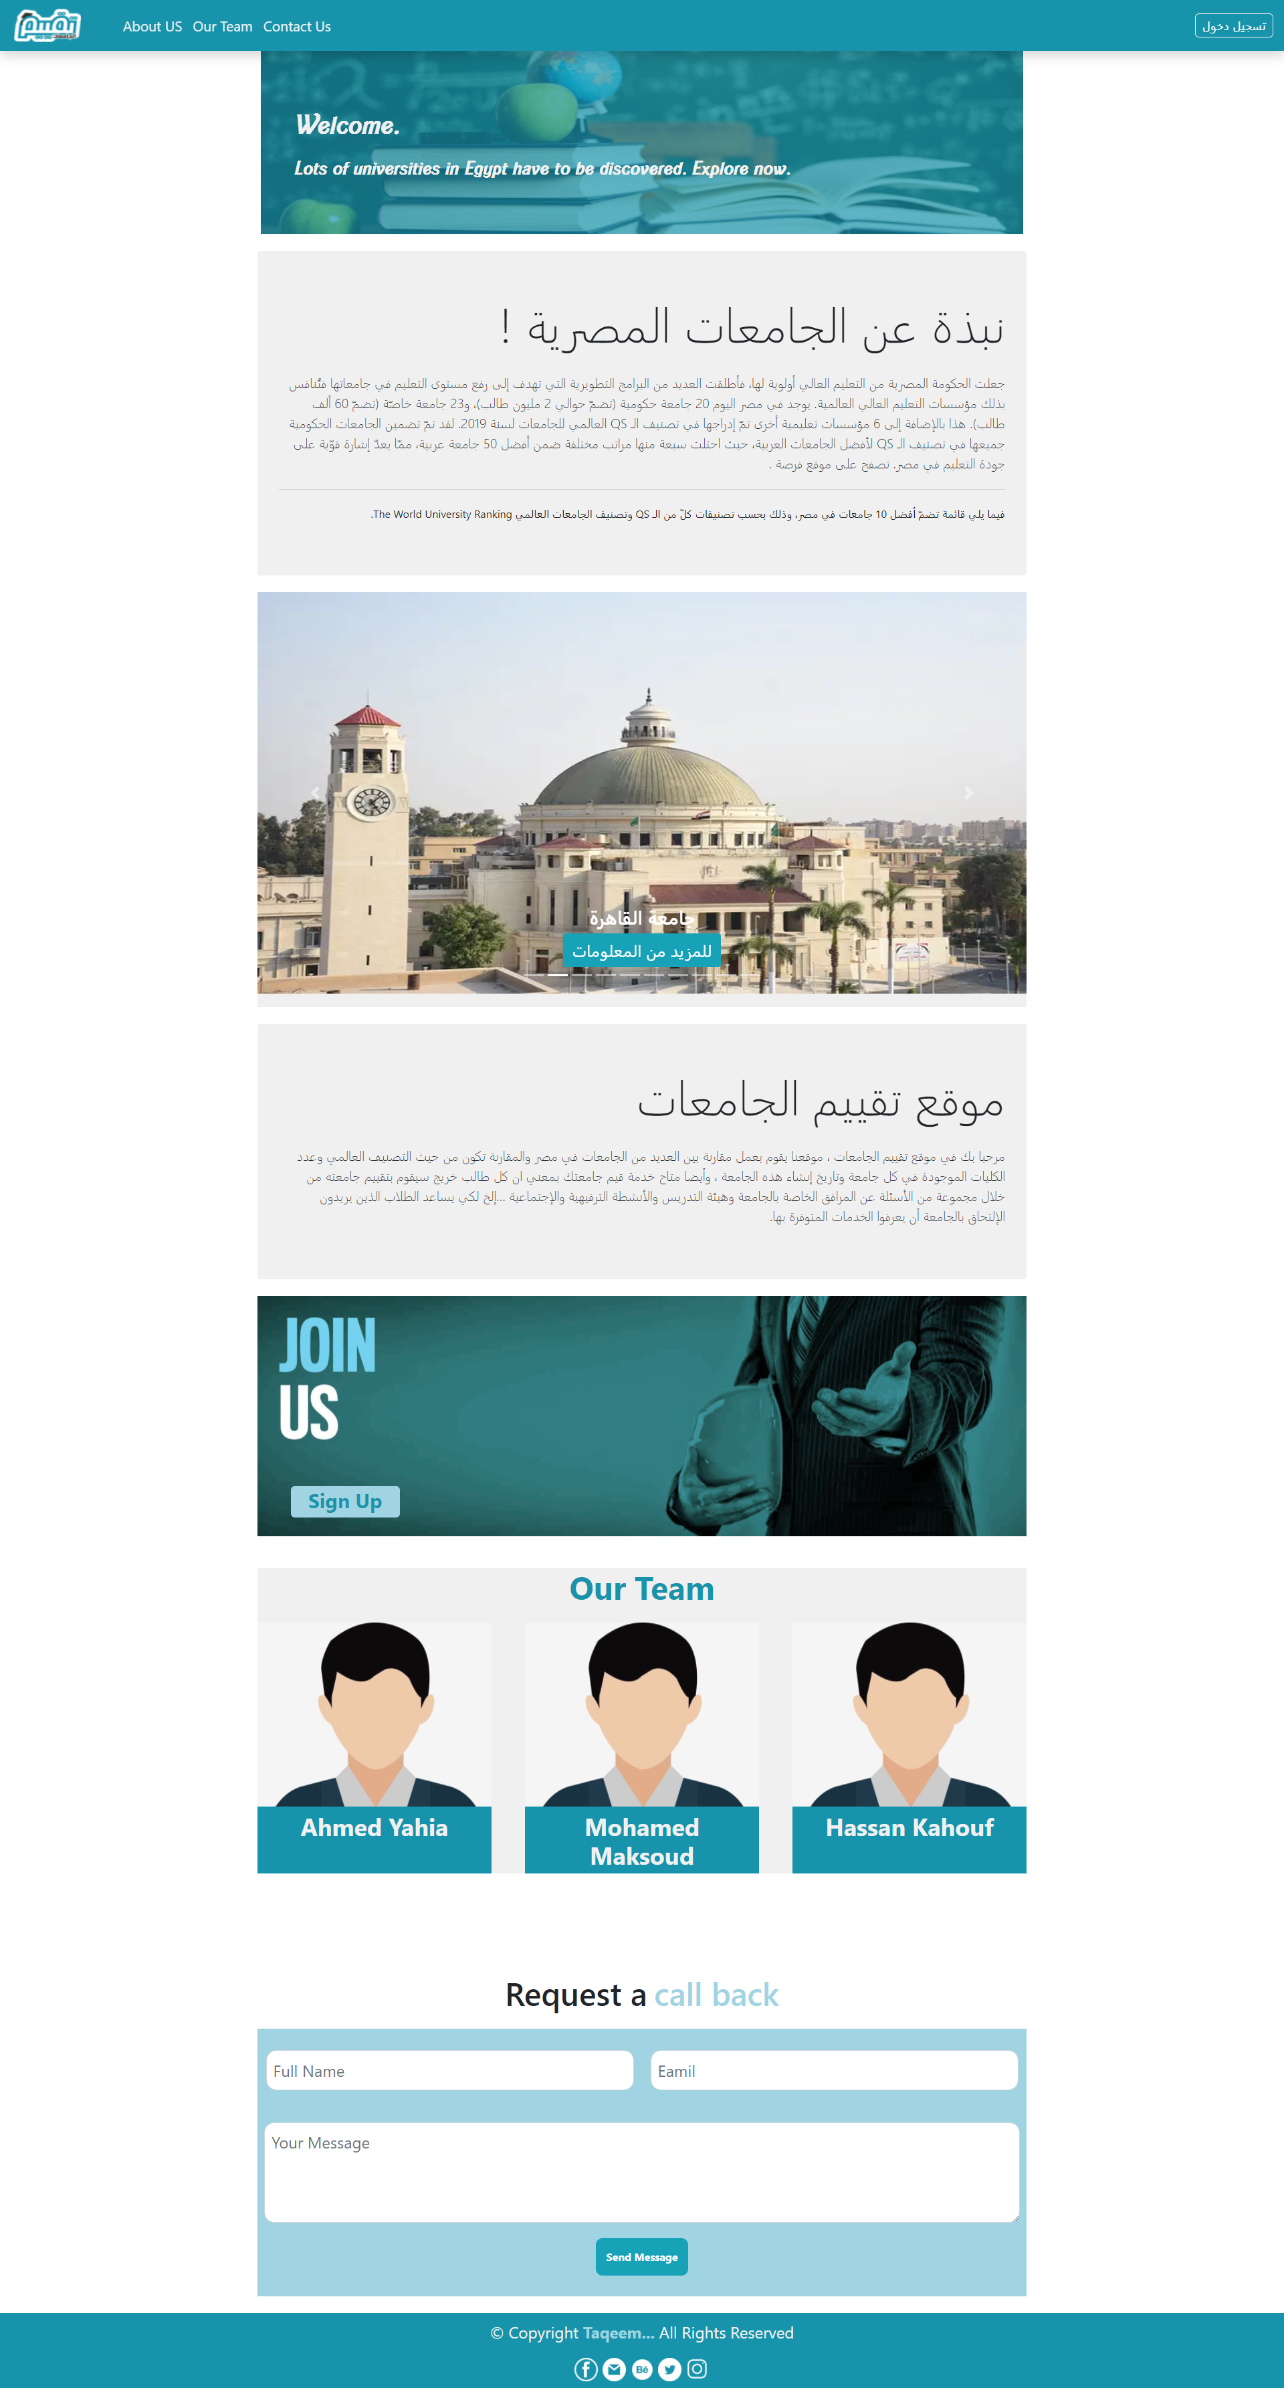
USER INTERFACES

Slide 21
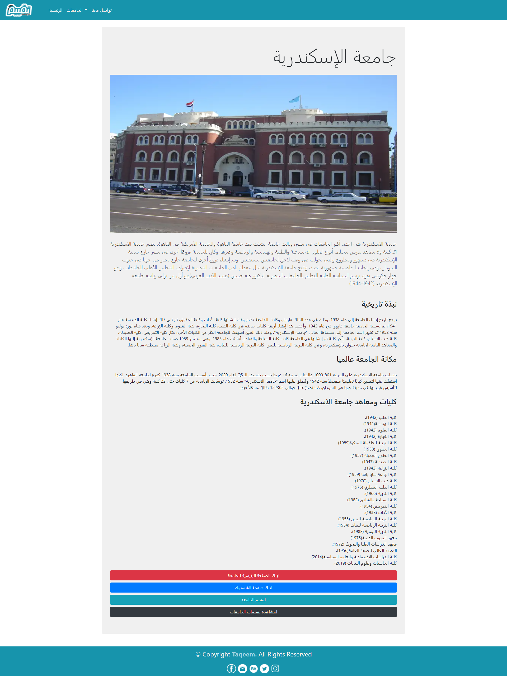
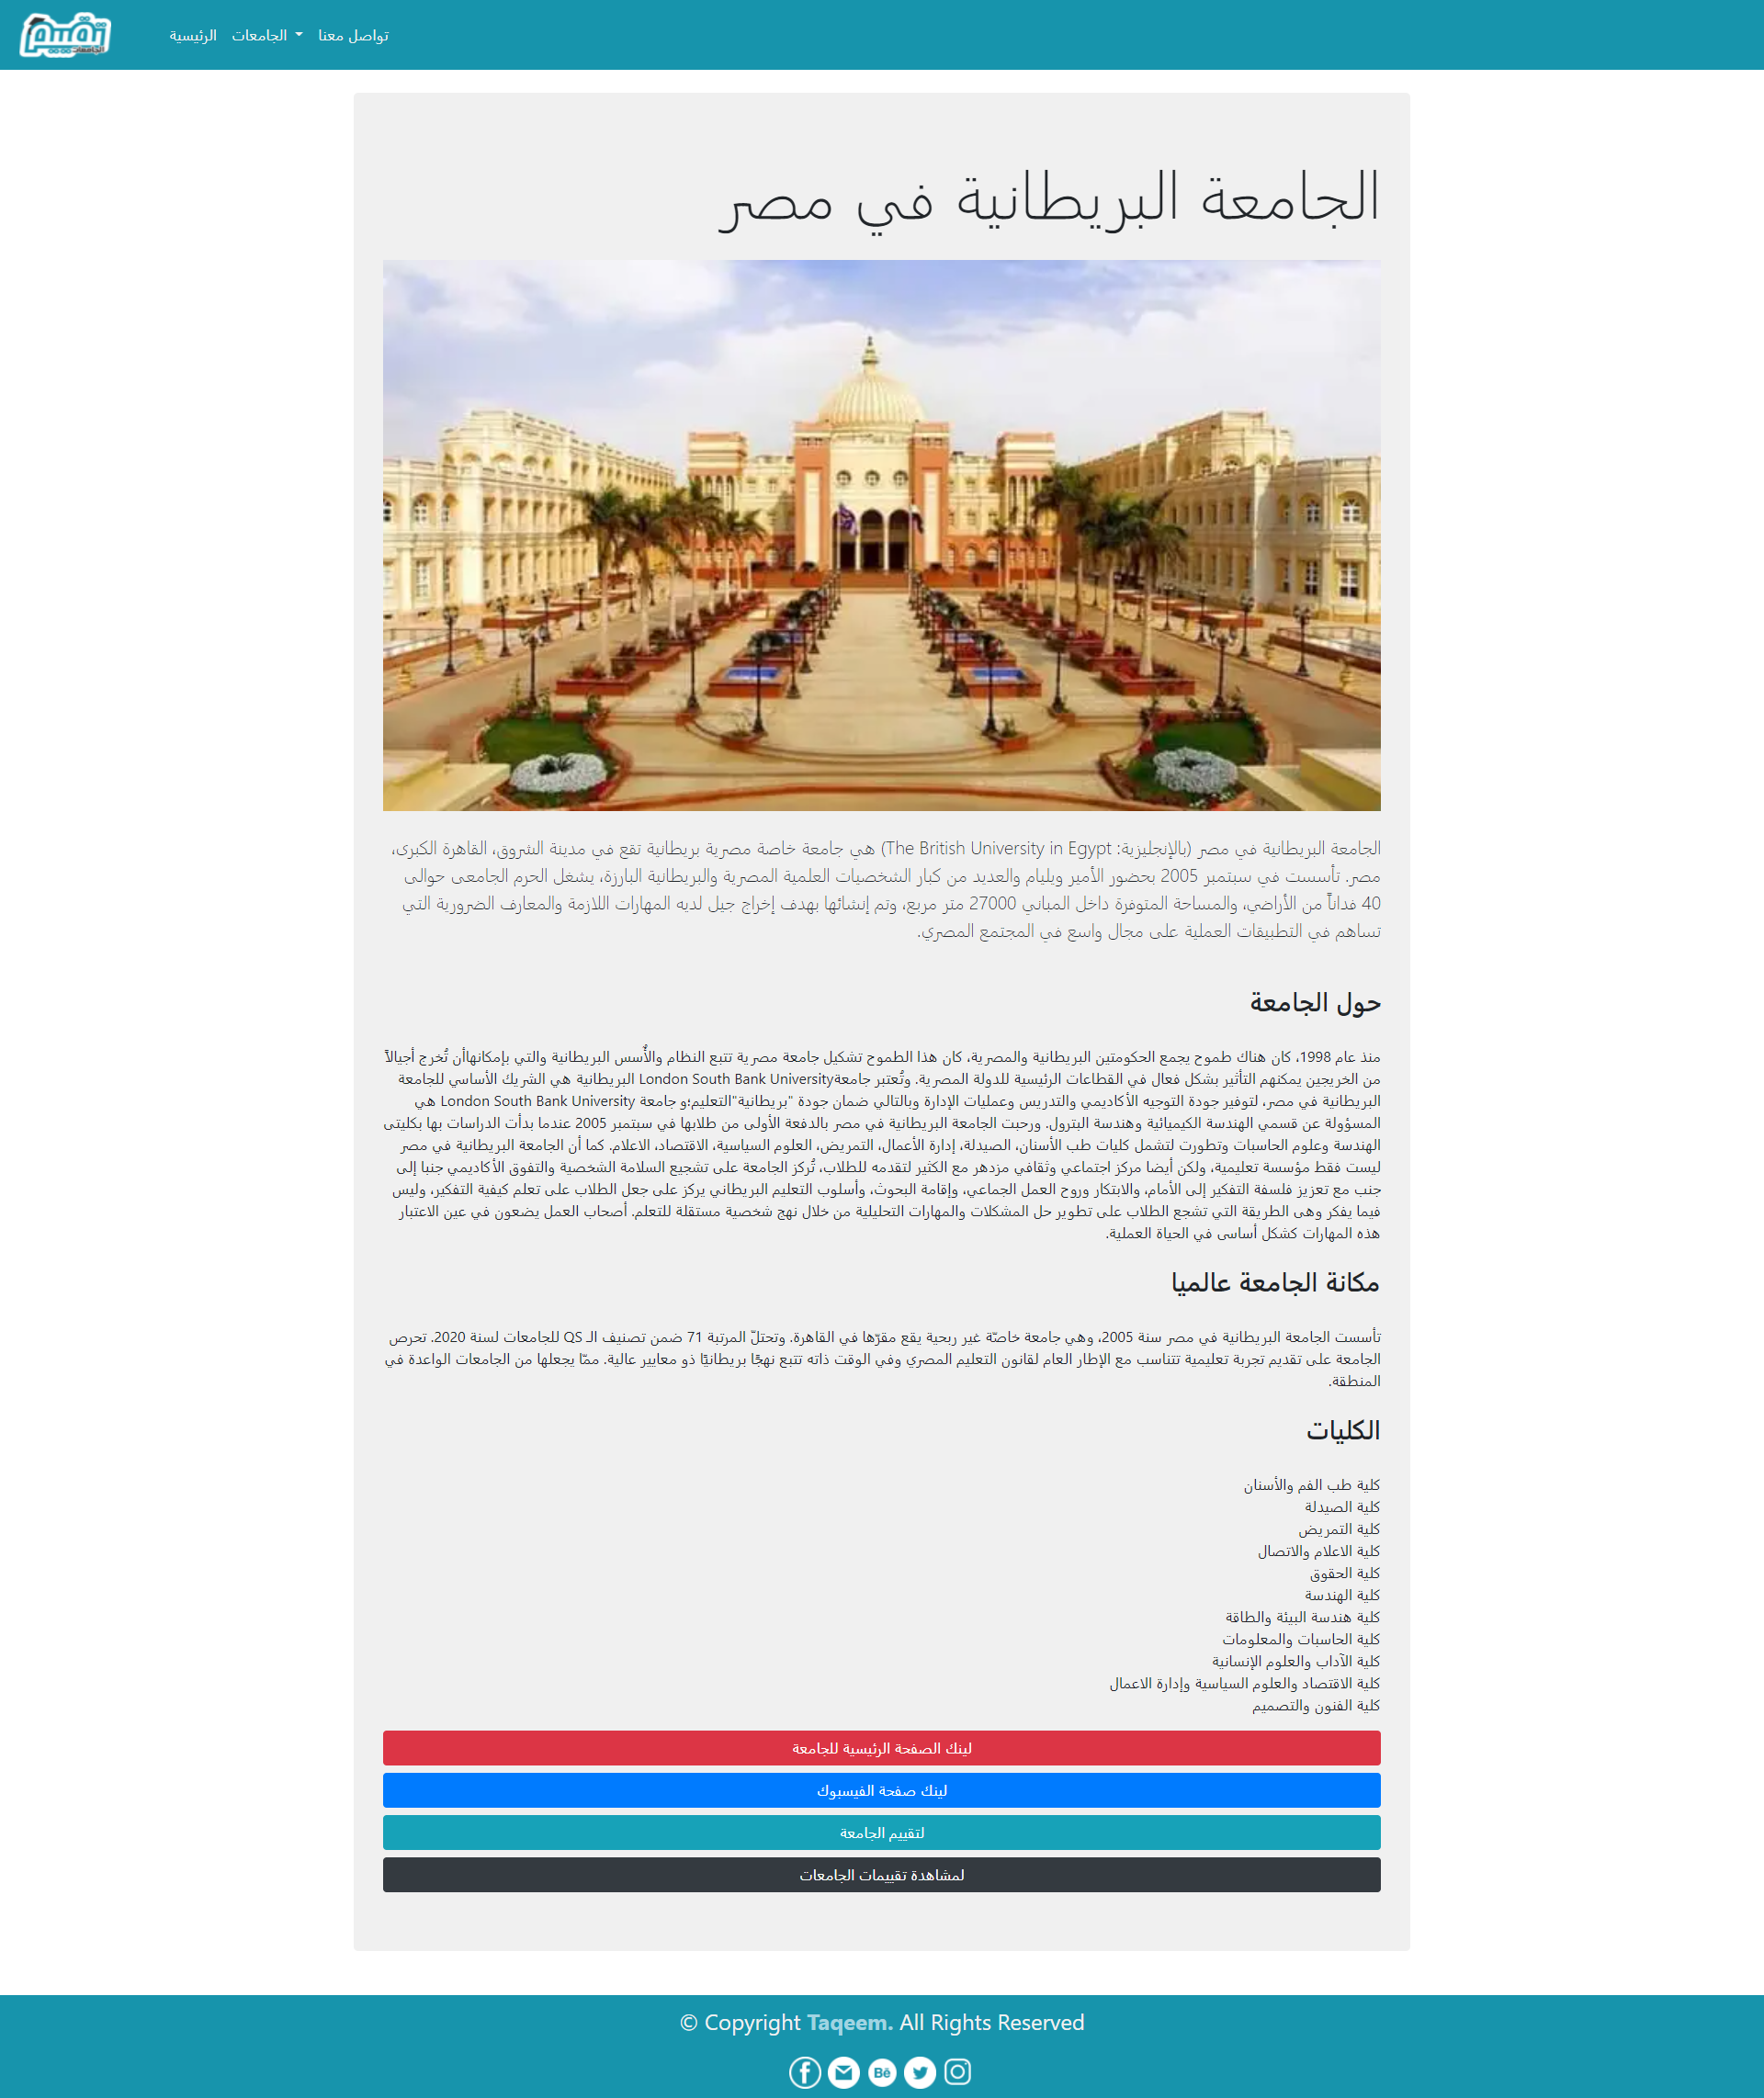
USER INTERFACES

Slide 22
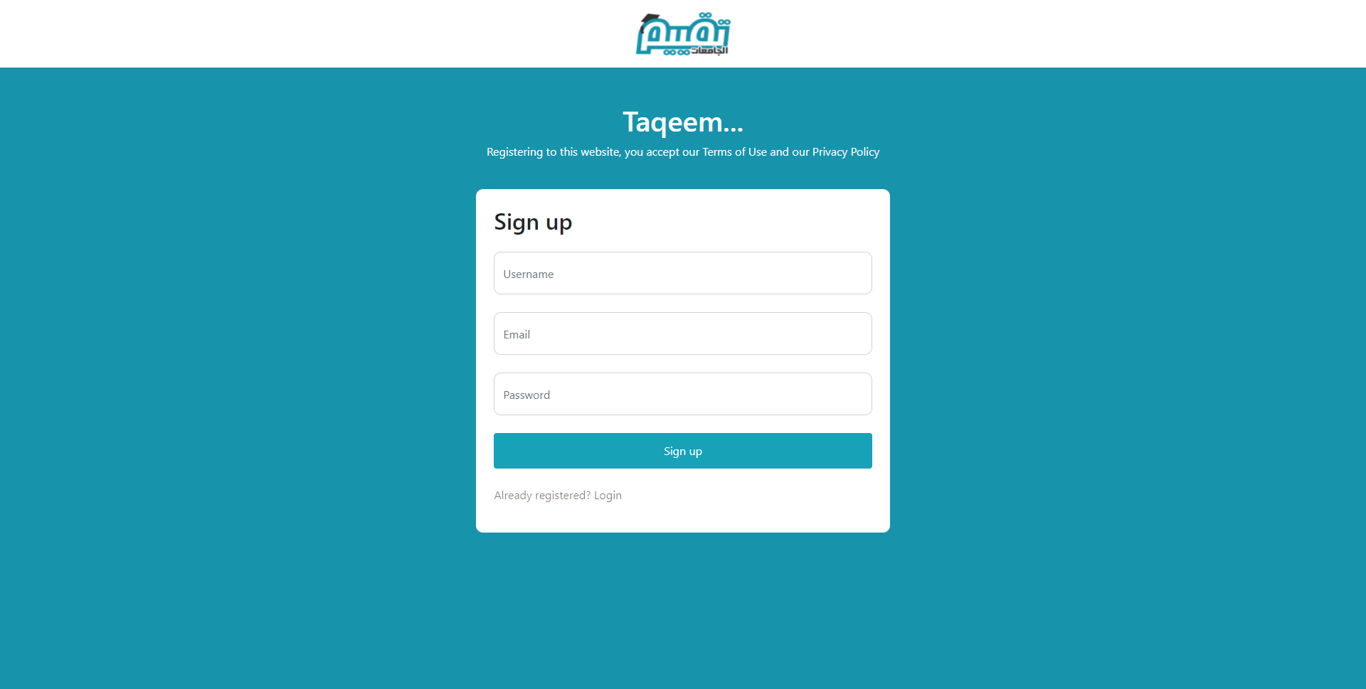
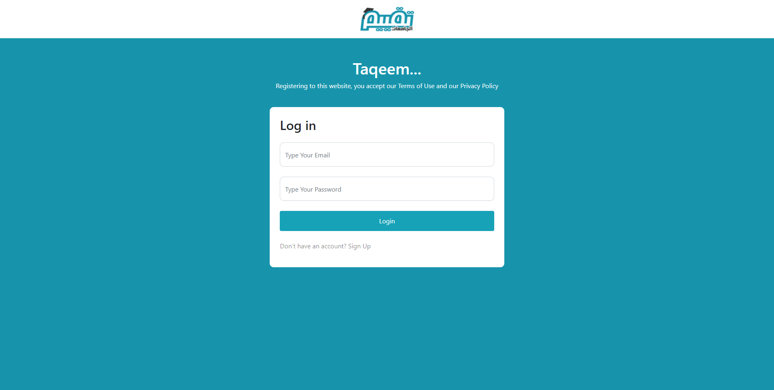
USER INTERFACES

Slide 23
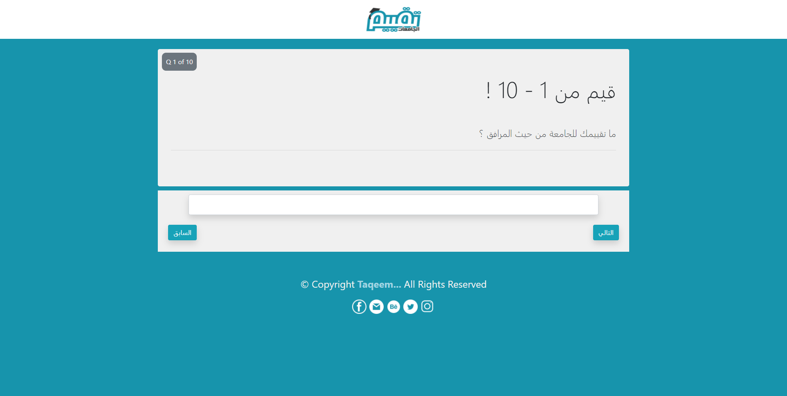
USER INTERFACES

Slide 24

USER INTERFACES

Slide 25
شكر وتقدير
فإنّا نشكر الله تعالى على فضله حيث أتاح لنا إنجاز هذا العمل بفضله، فله الحمد أولاً وآخراً.
ثم نشكر أولئك الأخيار الذين مدوا لنا يدَ المساعدة، خلال هذه الفترة، وفي مقدمتهم أساتذتنا المشرفين على المشروع الذين لم يدَّخروا جهداً في مساعدتنا:
الدكتور/ عمرو الشورى والدكتورة / ريهام عيسى والدكتورة / منى موافي والدكتورة / أميرة العطار
كما نشكر القائمين على هذه المؤسسة التعليمية وعلى رأسهم
معالي الدكتور/ محمد سامي راضي عميد المعهد.
ونتقدم بخالص الشكر للسادة الأساتذة المناقشين الذين استعموا إلينا بصدور رحبة، سائلين الله لهم تمام العافية.

Slide 26
THANKS!

